Slide 1

Introduction to programming with Python
ReDI School of Digital Integration

Slide 2
Who are we?

Slide 3
Who are you?
(Time to introduce yourself)

Slide 4
What is this course about?
What will you learn?
Basic programming concepts
Same for many modern programming languages (Python, Java, C++, PHP, Javascript etc.)
Words like: loop, variable, function, parameter, library etc.

Slide 5
What is this course about?
What will you learn?
Basic programming concepts
Same for many modern programming languages (Python, Java, C++, PHP, Javascript etc.)
Words like: loop, variable, function, parameter, library etc.
Programming skills
Problem analysis
Problem decomposition
Design and implementation
Testing and debugging

Slide 6
What is this course about?
What will you learn?
Basic programming concepts
Same for many modern programming languages (Python, Java, C++, PHP, Javascript etc.)
Words like: loop, variable, function, parameter, library etc.
Programming skills
Problem analysis
Problem decomposition
Design and implementation
Testing and debugging
Python syntax
Essential subset of Python3 features

Slide 7

What is this course about?
Don’t worry, it’s not a theoretical computers science course

Slide 8
What is this course about?
Don’t worry, it’s not a theoretical computers science course
Learning skills requires practicing

Slide 9

What is this course about?
Don’t worry, it’s not a theoretical computers science course
Learning skills requires practicing
We will have to code

Slide 10
What is this course about?
What will you be capable of at the end of the course?
Continue learning programming by yourself

Slide 11
What is this course about?
What will you be capable of at the end of the course?
Continue learning programming by yourself
Convert an idea into a working program

Slide 12
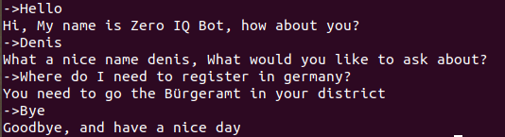
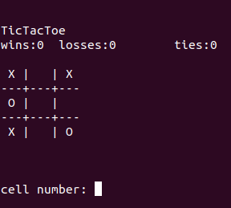
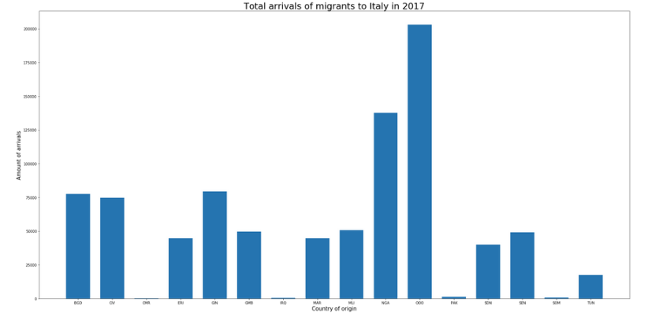
What is this course about?
What will you be capable of at the end of the course?
Continue learning programming by yourself
Convert an idea into a working program
Examples of projects
Chat bot
Dictionary
Simple console game
Data analysis/plots

Slide 13
How will we learn?
Class work: Theory + Programming tasks
Please ask questions
Slides and code samples are published

Slide 14
How will we learn?
Class work: Theory + Programming tasks
Please ask questions
Slides and code samples are published
Homework
Based on the previous class
Published after the lesson
Not mandatory but we highly recommend you to do it - programming is a skill and requires practice

Slide 15
How will we learn?
Class work: Theory + Programming tasks
Please ask questions
Slides and code samples are published
Homework
Based on the previous class
Published after the lesson
Not mandatory but we highly recommend you to do it - programming is a skill and requires practice
Feedback form
Please complain
https://goo.gl/forms/0vzhNp7qLigY84Wq2

Slide 16
How will we learn?
Class work: Theory + Programming tasks
Please ask questions
Slides and code samples are published
Homework
Based on the previous class
Published after the lesson
Not mandatory but we highly recommend you to do it - programming is a skill and requires practice
Feedback form
Please complain
https://goo.gl/forms/0vzhNp7qLigY84Wq2
Attendance tracking
You have to attend at least 80% of lessons to get the confirmation letter from ReDI

Slide 17
What is a program?
“Lives” inside a “computer”
Performs some task

Slide 18
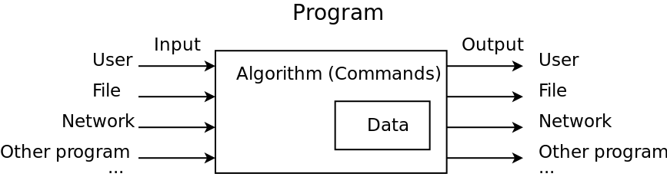
What is a program?
“Lives” inside a “computer”
Performs some task

Slide 19
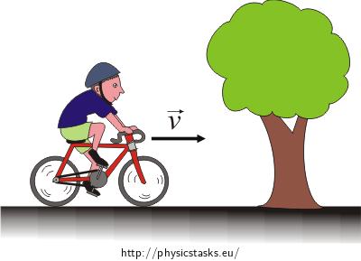
Algorithm
You have distance (S) and time (t), how to calculate the average speed?

Slide 20
Algorithm
You have distance (S) and time (t), how to calculate the average speed?
1st attempt: “Divide S by t”
Computer doesn’t know, what S and t is

Slide 21
Algorithm
You have distance (S) and time (t), how to calculate the average speed?
1st attempt: “Divide S by t”
Computer doesn’t know, what S and t is
2nd attempt:
Request and remember a number for S
Request and remember a number for t
Divide S by t and remember the result
Print the result

Slide 22
Algorithm
You have distance (S) and time (t), how to calculate the average speed?
1st attempt: “Divide S by t”
Computer doesn’t know, what S and t is
2nd attempt:
Request and remember a number for S
Request and remember a number for t
Divide S by t and remember the result
Print the result
3rd attempt: ...

Slide 23

How to explain an algorithm to a computer

Slide 24
How to explain an algorithm to a computer
Physical hardware (CPU) has a set of commands (100-500 commands) - instruction set

Slide 25
How to explain an algorithm to a computer
Physical hardware (CPU) has a set of commands (100-500 commands) - instruction set
Not really readable for a human: “move 16 bytes from address xxx to address yyy”

Slide 26
How to explain an algorithm to a computer
Physical hardware (CPU) has a set of commands (100-500 commands) - instruction set
Not really readable for a human: “move 16 bytes from address xxx to address yyy”
Natural human language is not formal enough - hard for computer to understand (yet)

Slide 27
How to explain an algorithm to a computer?
High-level programming languages (Python, C++, Java, Javascript etc)
Formal
Can be read and written by humans
Can be compiled as or interpreted to instruction set

Slide 28
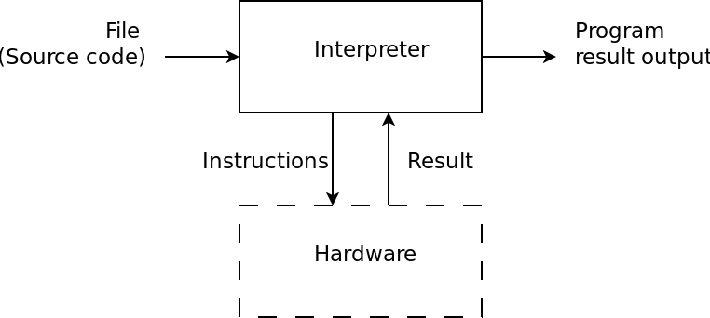
How to explain an algorithm to a computer?
High-level programming languages (Python, C++, Java, Javascript etc)
Formal
Can be read and written by humans
Can be compiled as or interpreted to instruction set

Slide 29
Why Python?
1994: Version 1
Not young (But is actively developed)
Mature

Slide 30
Why Python?
1994: Version 1
Not young (But is actively developed)
Mature
Goals (some of them)
Easy and intuitive but as powerful as those of the major competitors
Suitable for everyday tasks allowing for short development times
Open-source (free)

Slide 31
Why Python?
1994: Version 1
Not young (But is actively developed)
Mature
Goals (some of them)
Easy and intuitive but as powerful as those of the major competitors
Suitable for everyday tasks allowing for short development times
Open-source (free)
Many areas of application
Web-development (backend)
Automation (e.g. automated testing)
Robotics (prototyping)
Artificial Intelligence
Data Science

Slide 32






Why Python?
Python in Web:
Youtube
Dropbox
Google
Quora
Instagram
BitTorrent (Earlier Version)
Spotify
Reddit
Pinterest
BitBucket
EVE Online MMOPG
Mercurial Source Control
Other areas: https://www.python.org/about/success/

Slide 33
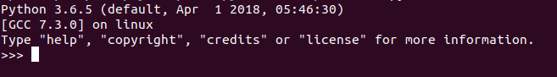
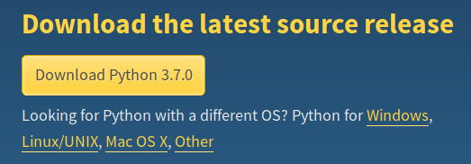
Setting up Python3
Linux: Should be installed: open Terminal (Ctrl+Alt+T on Ubuntu) and type python3:
Windows & MacOSx: If not installed (nothing with the word Python in start menu), go to https://www.python.org/downloads/ download and install latest 3.x version

Slide 34
You’re good to go
You have have the interpreter installed (Python3)

Slide 35
You’re good to go
You have have the interpreter installed (Python3)
You can use any text editor to create a python source file and “feed it to the interpreter”

Slide 36
You’re good to go
You have have the interpreter installed (Python3)
You can use any text editor to create a python source file and “feed it to the interpreter”
But…

Slide 37
You’re good to go
You have have the interpreter installed (Python3)
You can use any text editor to create a python source file and “feed it to the interpreter”
But…
We’ll be using IDE (Integrated development environment) in this course
Very convenient code editor
Has button “Run”
...

Slide 38
Installing PyCharm
Ubuntu
In Terminal: sudo snap install pycharm-community --classic
Not Ubuntu:
Go to: https://www.jetbrains.com/pycharm/download/
Choose Community Edition
Windows:
Install the downloaded file
Other Linux (Not Ubuntu)
Uncompress the downloaded file
In Terminal type: 'cd <path of bin folder inside the extracted folder>'
then type 'sh pycharmXXX.sh'

Slide 39
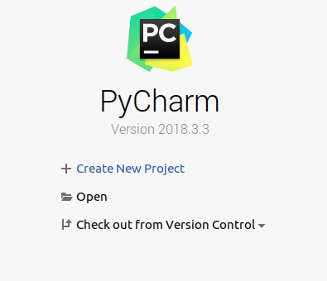
Running your first program
Open PyCharm
Click "Create new project"

Slide 40
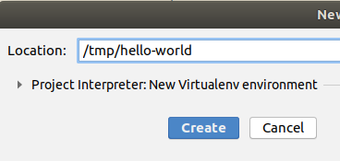
Running your first program
Set the location and the name of the project (this is the location where your programs will be stored)
Click "Create"

Slide 41
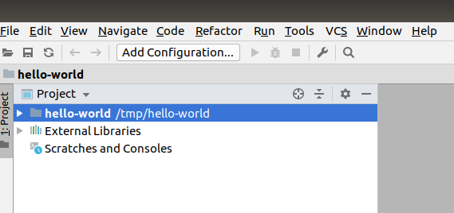
Running your first program
Right-click on the project-name
Select "New" -> "Python File"

Slide 42
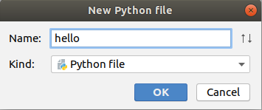
Running your first program
Give your file a name
Click "OK"

Slide 43
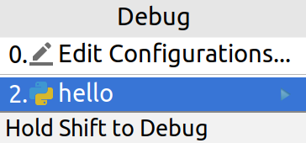
Running your first program
Type the following code in your file
Save and click Run -> Run... and select your project
print('hello world!')

Slide 44
Running your first program
Check the result at the bottom of the window
/home/grafov/venv/tmp/bin/python /tmp/tmp/hello.py
Hello world
Process finished with exit code 0

Slide 45
Understanding your first program
Built-in functions:
Part of the language
Sub-program
Has unique name, effect or result, list of arguments (parameters)
https://docs.python.org/3/library/functions.html
Literals:
Represent fixed values in code
Different types: numbers (also floating-point), boolean, string and some others
print(...)
'hello world!'

Slide 46
Understanding your first program
One more very important thing for your first program
# This is my first program in Python
# It prints the line 'Hello world' to
# the console output
print('hello world!')

Slide 47
Understanding your first program
One more very important thing for your first program
# This is my first program in Python
# It prints the line 'Hello world' to
# the console output
print('hello world!')
Comments
Ignored by the interpreter
Write it for yourself or for somebody else who is supposed to read your code in future
You can use it to disable lines of code in your program without deleting them

Slide 48
Breaking your first program
# This is my first program in Python
# It prints the line 'Hello world' to
# the console output
Print('hello world!')

Slide 49
Breaking your first program
# This is my first program in Python
# It prints the line 'Hello world' to
# the console output
Print('hello world!')
Traceback (most recent call last):
File "hello.py", line 5, in <module>
Print('Hello world!')
NameError: name 'Print' is not defined

Slide 50
Breaking your first program
# This is my first program in Python
# It prints the line 'Hello world' to
# the console output
Print('hello world!')
Traceback (most recent call last):
File "hello.py", line 5, in <module>
Print('Hello world!')
NameError: name 'Print' is not defined
If you can’t understand it right away, usually it’s enough to search for the text of an error: https://duckduckgo.com/?q=python3+NameError%3A+name+%27Print%27+is+not+defined&t=canonical&ia=web

Slide 51
Multi-instruction program
# This is my first multi-instruction
# program in Python: It prints two
# lines to the console output
print('hello world!')
print("My name is Denis")

Slide 52
Multi-instruction program
# This is my first multi-instruction
# program in Python: It prints two
# lines to the console output
print('hello world!')
print("My name is Denis")
Only one “instruction” per line
Empty lines are allowed
Instructions are executed one after another
Look at the quotes (both ways work with string literals)

Slide 53
Additional materials and where to find help
https://automatetheboringstuff.com/ - Online book, covers all the basics of Python and how to use it

Slide 54
Additional materials and where to find help
https://automatetheboringstuff.com/ - Online book, covers all the basics of Python and how to use it
https://docs.python.org/3/index.html - Python3 documentation (including Tutorial)

Slide 55
Additional materials and where to find help
https://automatetheboringstuff.com/ - Online book, covers all the basics of Python and how to use it
https://docs.python.org/3/index.html - Python3 documentation (including Tutorial)
Internet search - community is big, many questions were already posted somewhere
Pay special attention to the information at stackoverflow.com

